Slide 1
















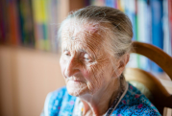
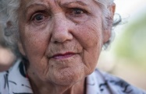
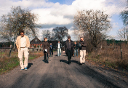
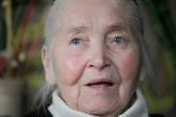
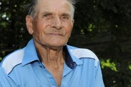




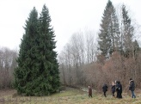
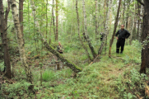
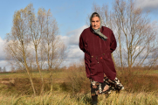
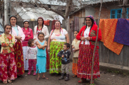

Holocaust by Bullets
Life and Death of a Jewish Community in Lithuania

Slide 2
I. Introduction

Slide 3
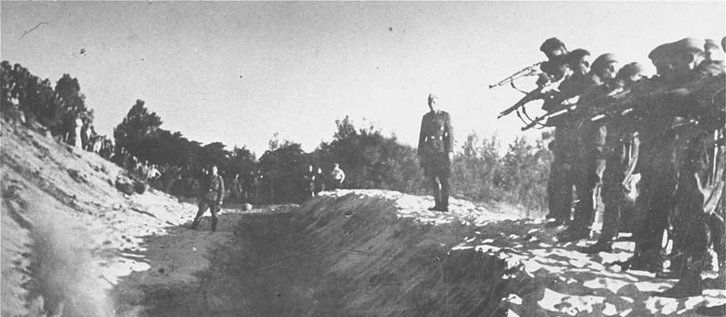
Holocaust by Bullets
Over two million Jews were murdered by German units and local collaborators in Eastern Europe
The shootings continued alongside the existence of extermination camps like Auschwitz-Birkenau
Many of the crimes were committed in public, in front of non-Jewish witnesses
Members of an Einsatzkommando firing at a group of men standing at the bottom of a trench. Circa: 1941-1942. Whereabouts unknown. Photographer unknown. © USHMM, courtesy of Dokumentatioarchiv of the Oesterreichischen Widerstandes

Slide 4
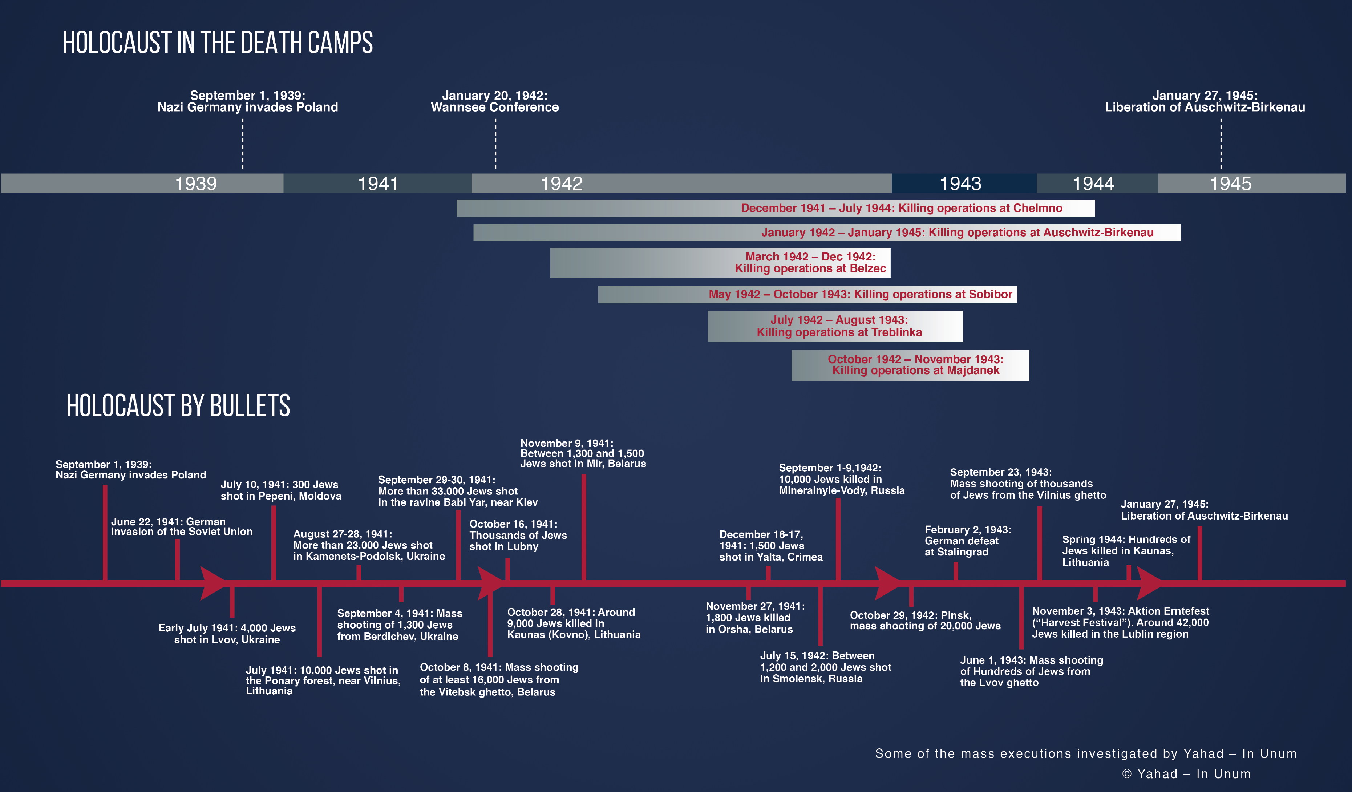
Timeline of the Holocaust

Slide 5
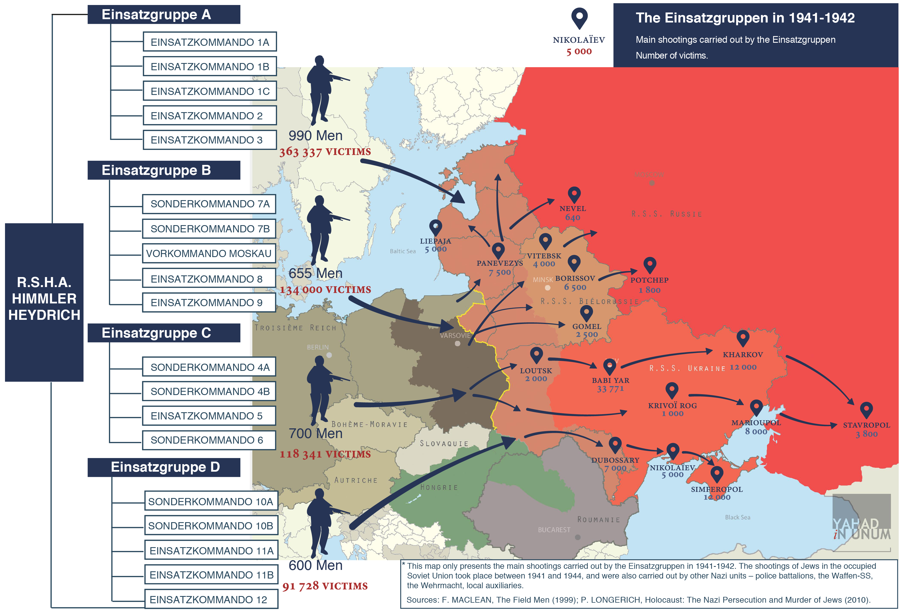

KAMANETS-PODOLSKI
23 000

Slide 6
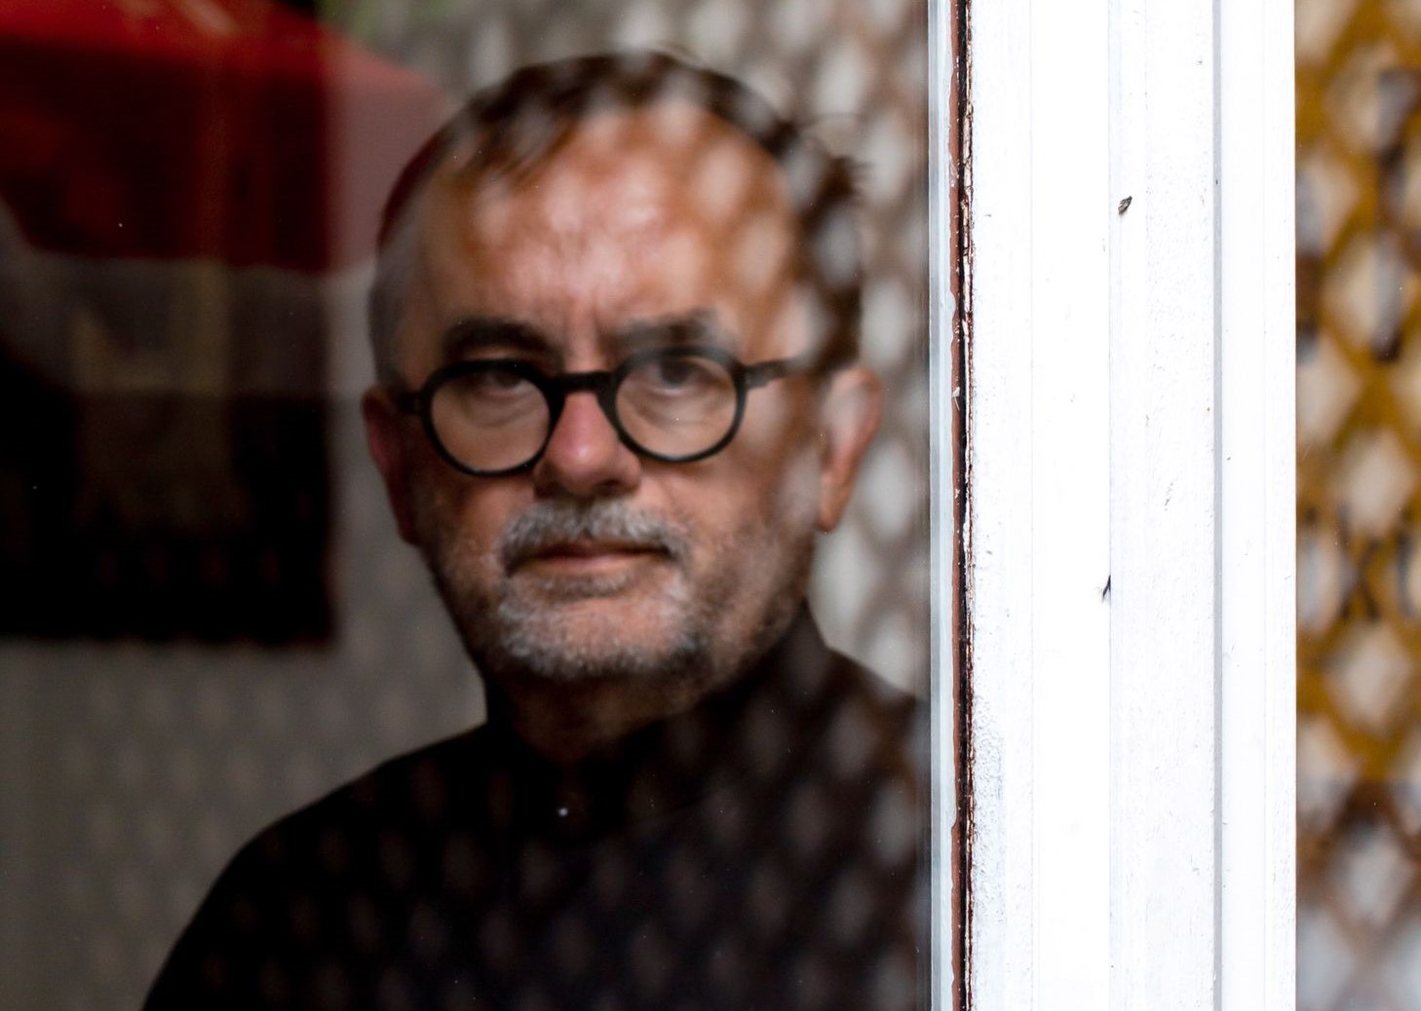
Yahad – In Unum
Founded in 2004 by Father Patrick Desbois
Dedicated to the study of genocide and mass violence
Renowned for its pioneering work in investigating the “Holocaust by Bullets”

Slide 7
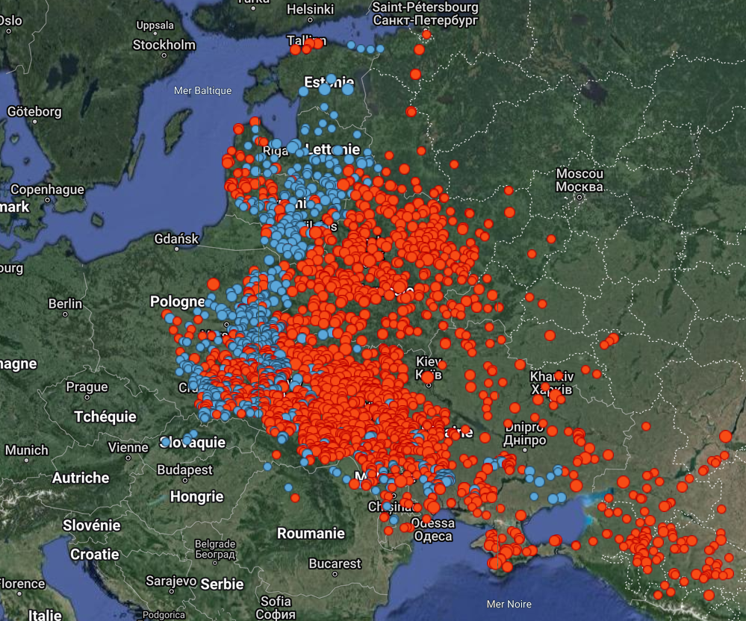


Yahad – In Unum’s Mission
To conduct field research by interviewing witnesses and locating the sites of mass graves
To document crimes committed against persecuted groups, such as the Jewish community, Roma, and Soviet prisoners of war
  Yahad has identified over 3,300 mass graves in ten countries (Ukraine, Russia, Belarus, Poland, Romania, Moldova, Lithuania, Latvia, Estonia, Slovakia)
To raise awareness and promote education in the fight against racism and extremism
8,000
3,300

Slide 8
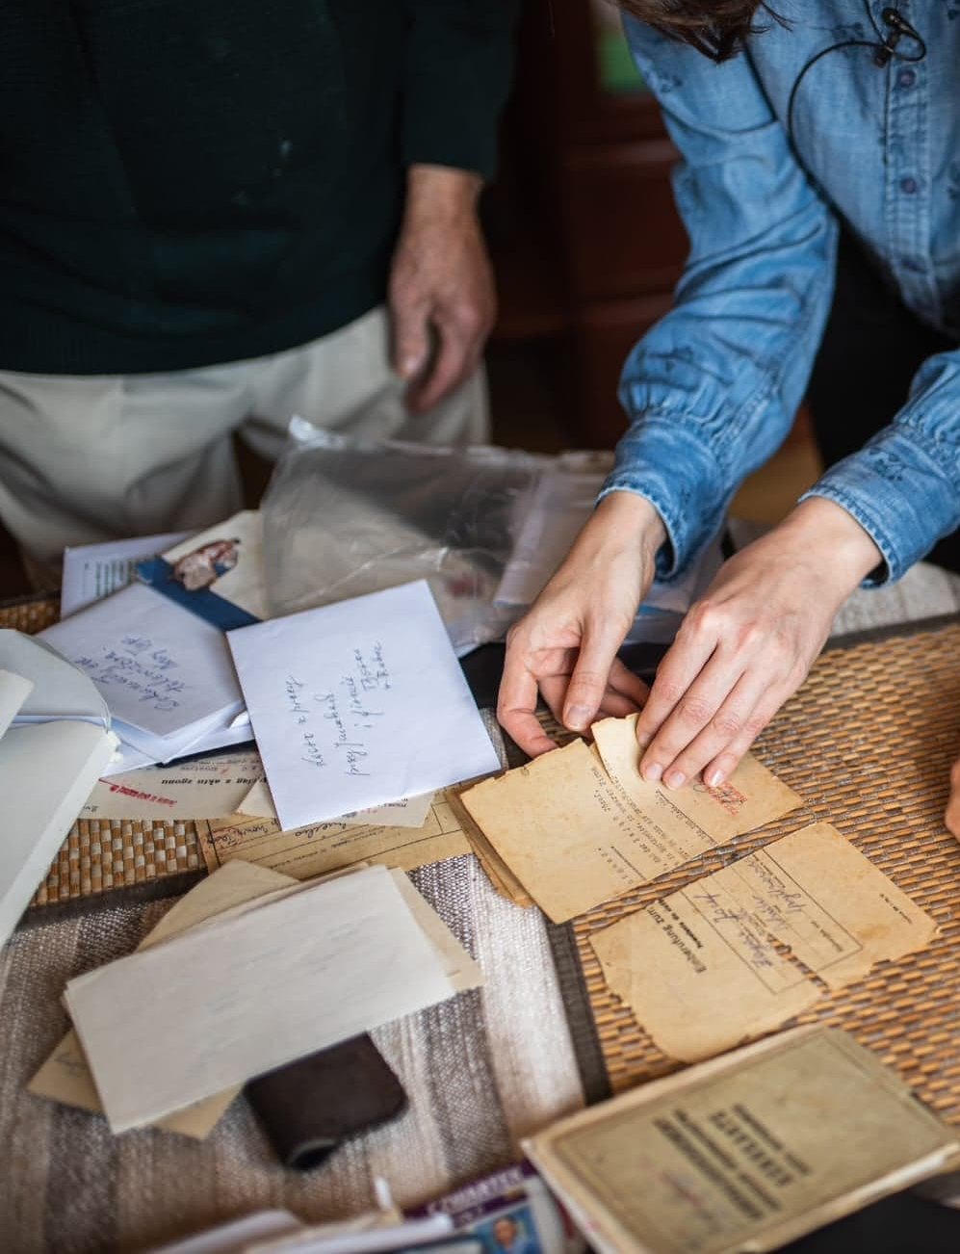
Investigative Methodology
Archival research is conducted before research trips to narrow down the areas of investigation
Various sources (archives, witness testimonies, site visits) are cross-referenced to establish historical facts

Slide 9
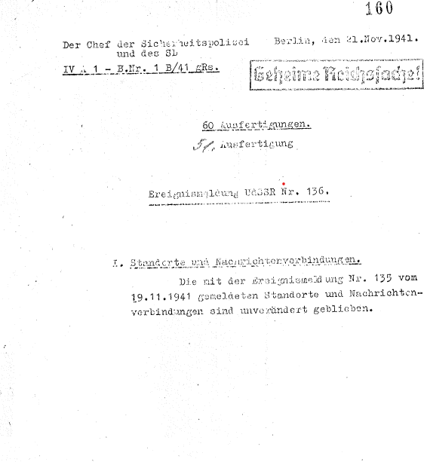
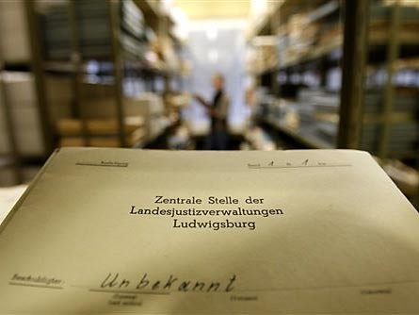
German Archives
Einsatzgruppen reports
Central Office of the State Justice Administrations in Ludwigsburg

Slide 10
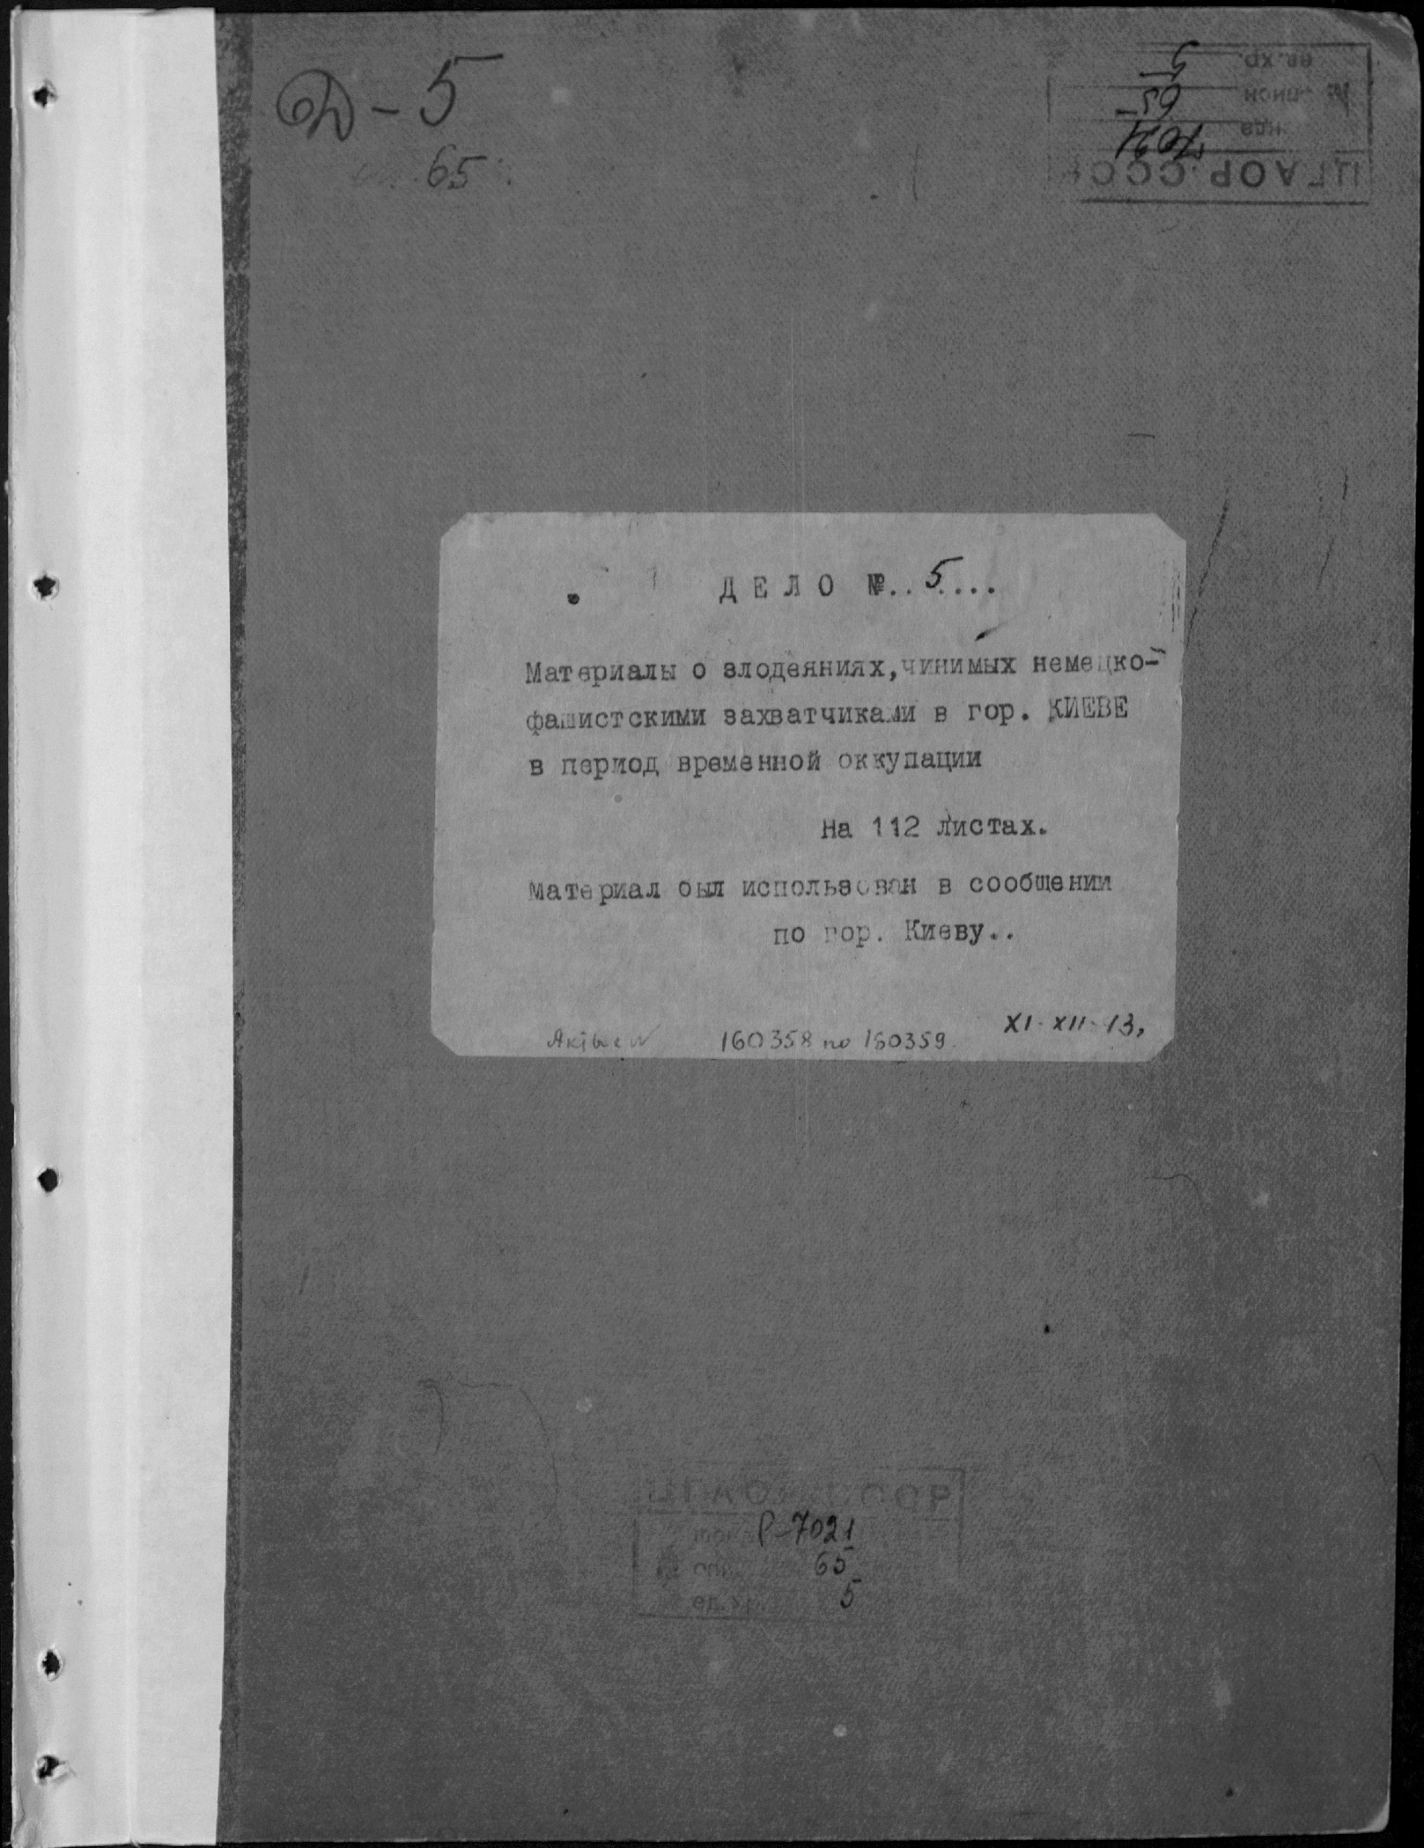
Soviet Archives
Extraordinary State Commission
KGB trials against the Nazis and their collaborators
GARF 7021-65-5

Slide 11
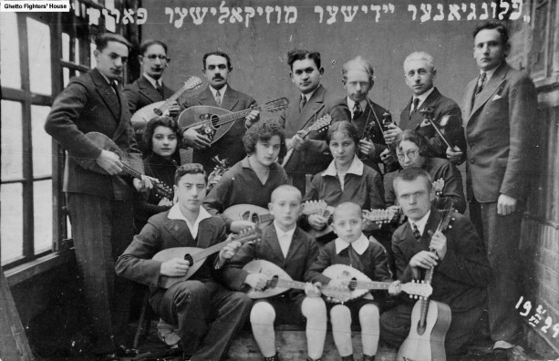
Lithuania
Country in the Baltic region
Centre for Jewish settlement and culture
Numerous shtetl (Jewish towns and villages)
Rich traditions, religious and cultural life
Jewish musicians. December 21, 1929. Plungė, Lithuania. Photographer unknown. © Ghetto Fighters’ House

Slide 12
Holocaust in Lithuania
June–July 1941: Germany invades the Soviet Union, occupies Lithuania
Lithuania incorporated into Reichskommissariat Ostland (German civilian administration)
June–July 1941: Einsatzgruppen and Lithuanian partisans begin mass shootings of Jews
Surviving ~40,000 Jews confined to ghettos (Vilna, Kovno, Siauliai, Svencionys) and labour camps
1943: Ghettos destroyed or converted to concentration camps
Summer–fall 1944: Soviet reoccupation
Majority of Lithuanian Jews murdered within first six months of occupation—one of Europe’s highest murder rates

Slide 13
II. Case Study

Slide 14
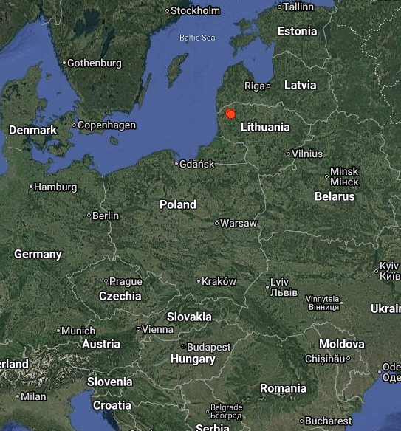
Plungė
Located in northwestern Lithuania
German armed forces captured Plungė on June 24, 1941
  At that time, 1,700 Jews lived in Plungė
Lithuanian nationalists implemented anti-Semitic measures

Slide 15
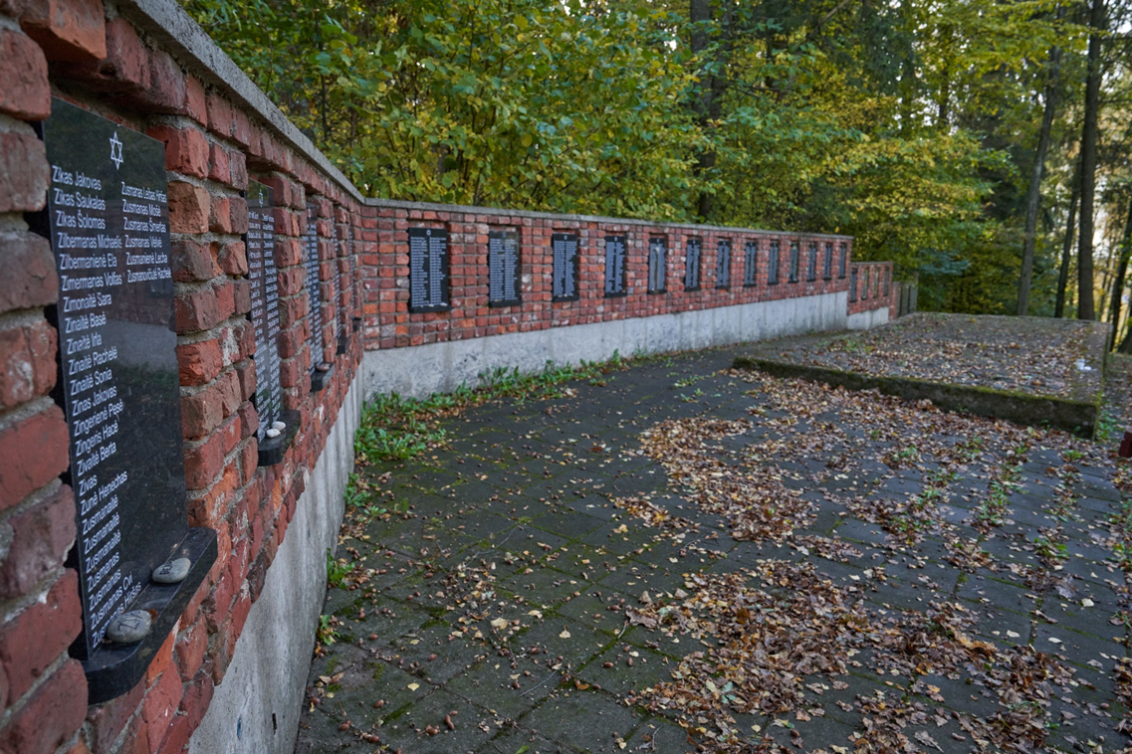
Plungė, Lithuania

Slide 16
Group Work
Read the archival document(s) in your packet of materials
Watch the assigned witness testimony for your group and take notes (under “Notes:” in your packet of materials)
Discuss the set of questions in your packet of materials with your group

Slide 17
III. Discussion

Slide 18
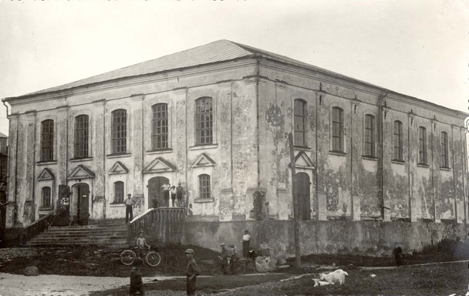
1. The Ghetto
Synagogue in Plungė. Date unknown. Plungė, Lithuania. Photographer unknown. Courtesy of Miestai.net

Slide 19
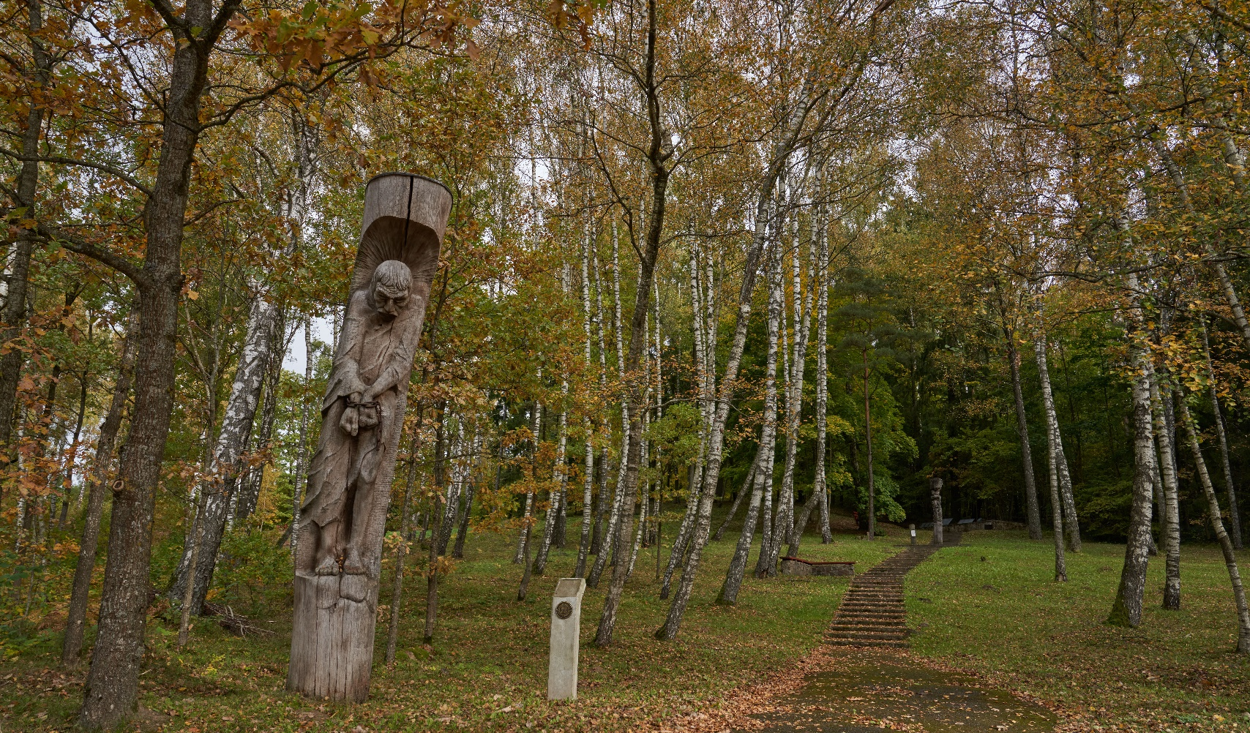
2. The Shooting
Killing site at Kaušėnai. 2024. Kaušėnai, Lithuania. Jordi Lagouette.

Slide 20
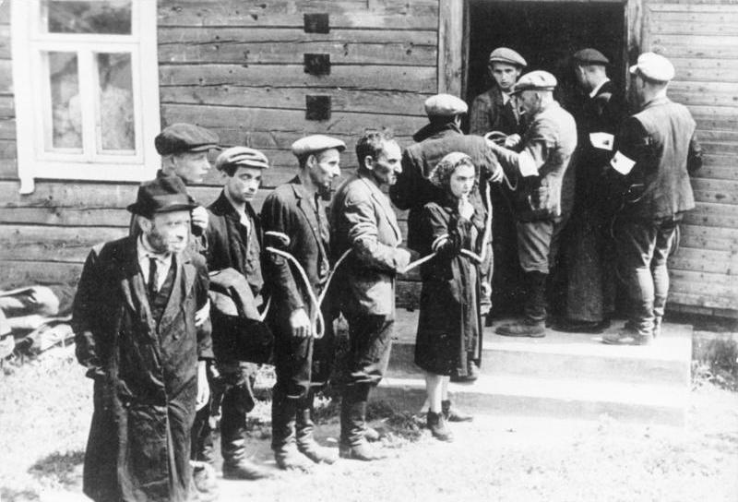
3. The Perpetrators
* The 'White Armbands’
The term 'White Armbands' was one of many designations for the Lithuanian TDA battalion (Lithuanian: Tautinio darbo apsaugos; lit.: "National Labor Service"). At the beginning of Operation Barbarossa, it was set up by the Provisional Government of Lithuania as a paramilitary battalion and was intended to form the basis for a future independent Lithuanian army but was taken over by the Nazis and reorganized into the Lithuanian auxiliary police battalions. These two units actively participated in the mass murder of Jews in Lithuania and Belarus.
Arrest of the Jews by Lithuanian Partisans*. 1941. Lithuania. German Federal Archives. Bundesarchiv, Bild 183-B12290 / CC-BY-SA 3.0

Slide 21
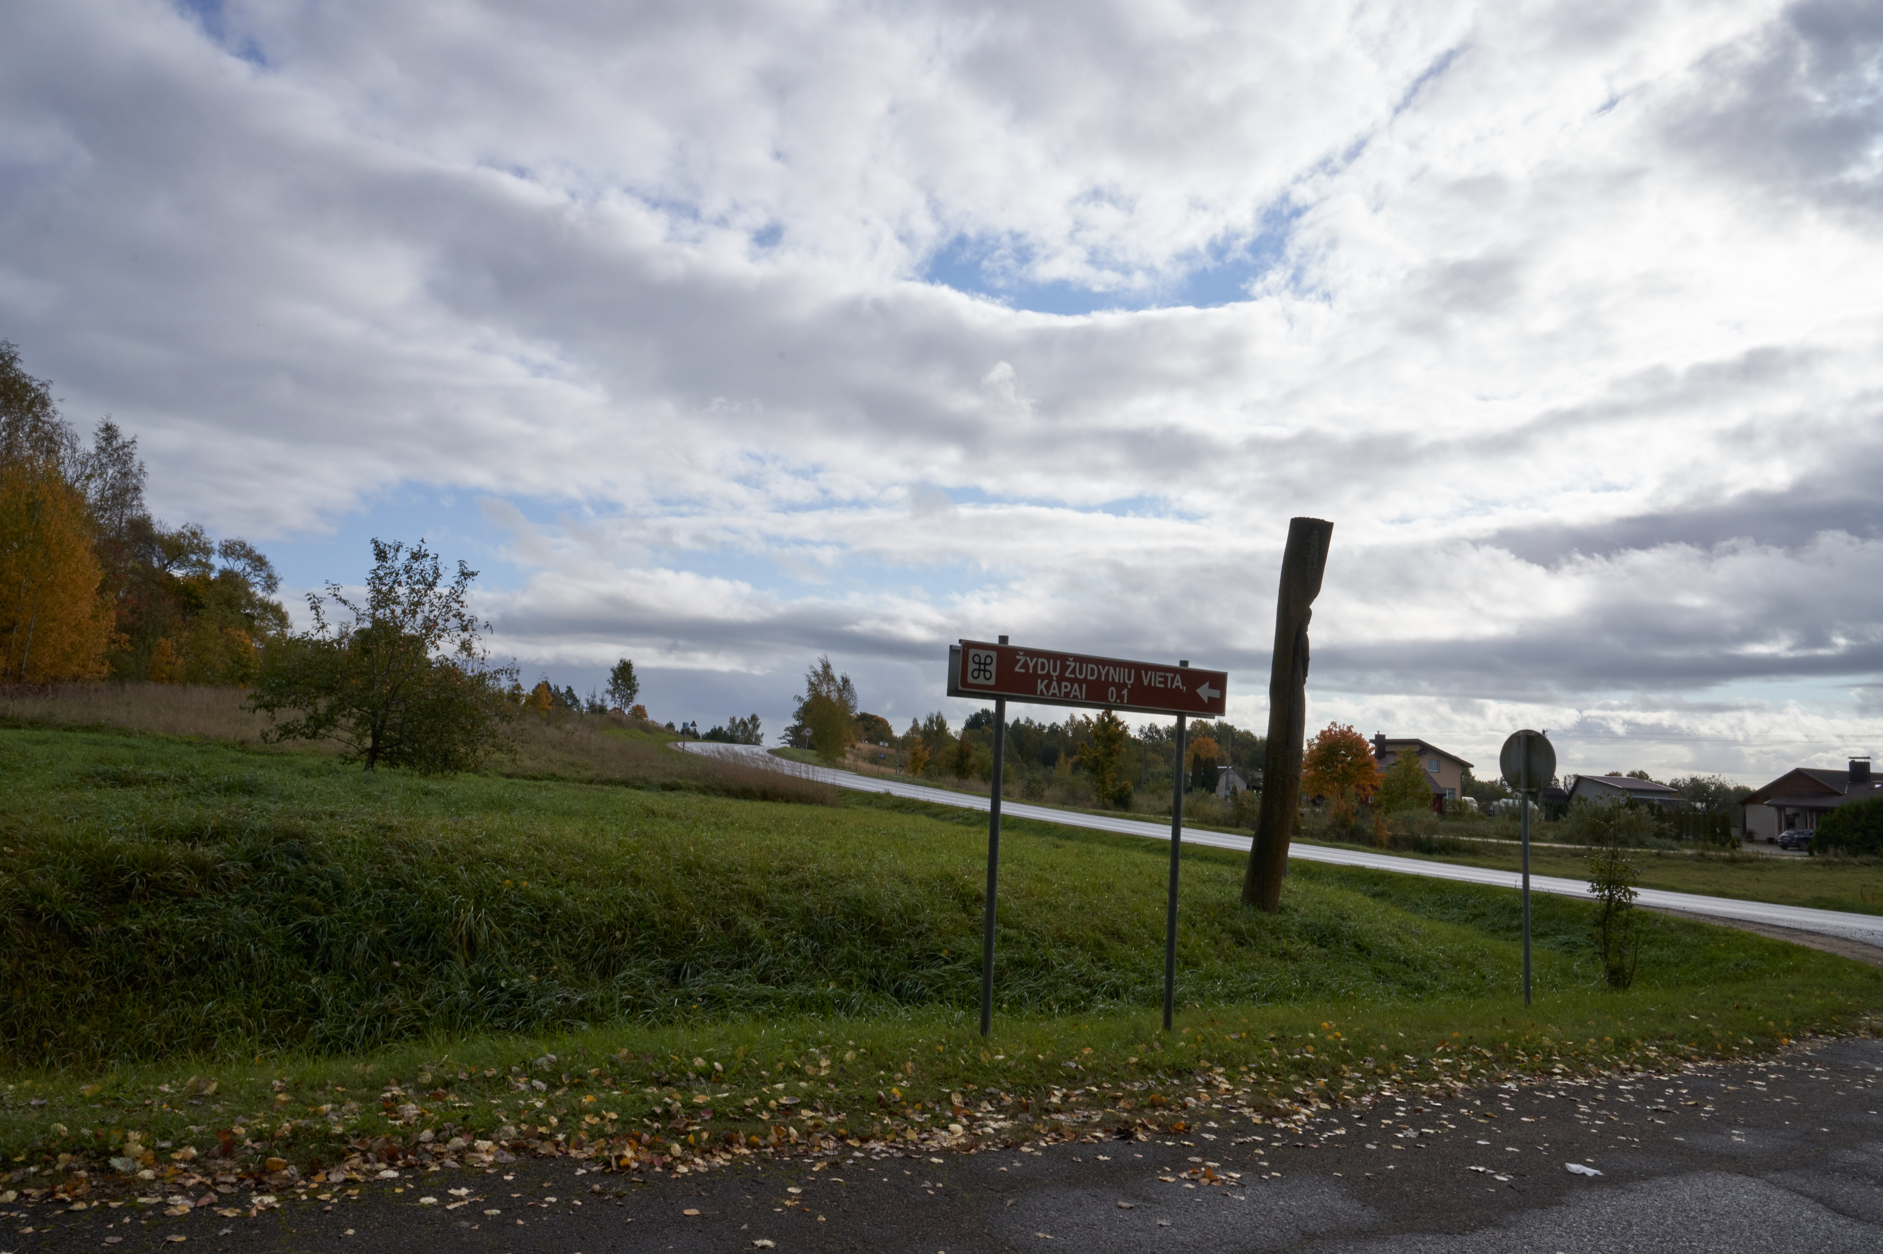
4. The Public Nature of the Crime
Road between Kaušėnai and Plungė. 2024. Kaušėnai, Lithuania. Yahad – in Unum.

Slide 22
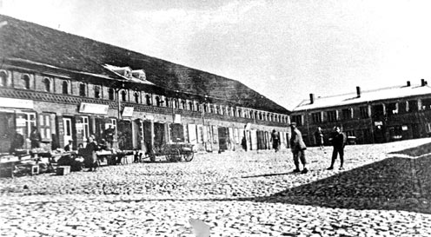
5. Jewish Life Before and After
Jewish shops in Plungė. Circa: 1930. Plungė, Lithuania. Photographer unknown. Courtesy of Miestai.net

Slide 23
Create a Timeline of the Events in Plungė
1.
2.
3.
4.
5.
6.
7.
8.
9.
  Put the following events in the correct order:
  a. Jews loaded onto trucks and brought to Kaušėnai
  b. Lithuanian partisans shoot the Jews
  c. Jews gathered in the ghetto (synagogue)
  d. Jews accused of starting the fire
  e. Arrival of German troops in Plungė
  f. Jews’ possessions plundered
  “Fire” breaks out in Plungė
  Jews gathered in front of the synagogue
  Jews walk in the column

Slide 24
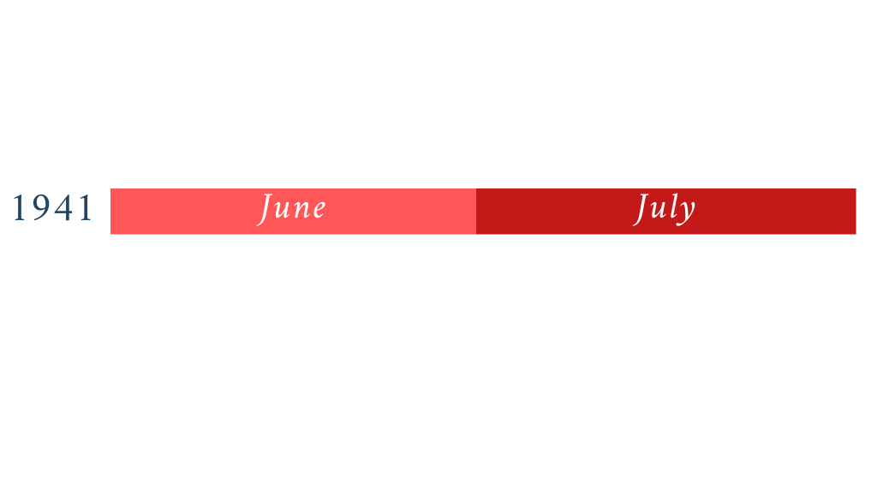
Timeline of the Events in Plungė

Slide 25
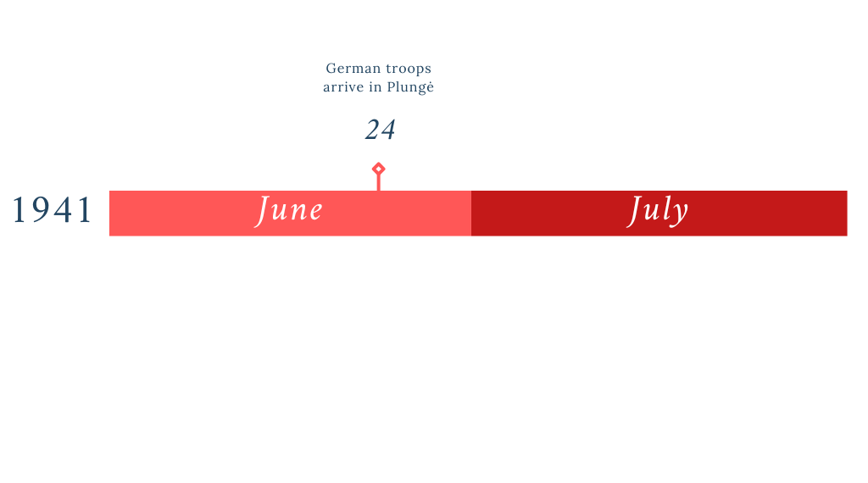
Timeline of the Events in Plungė

Slide 26
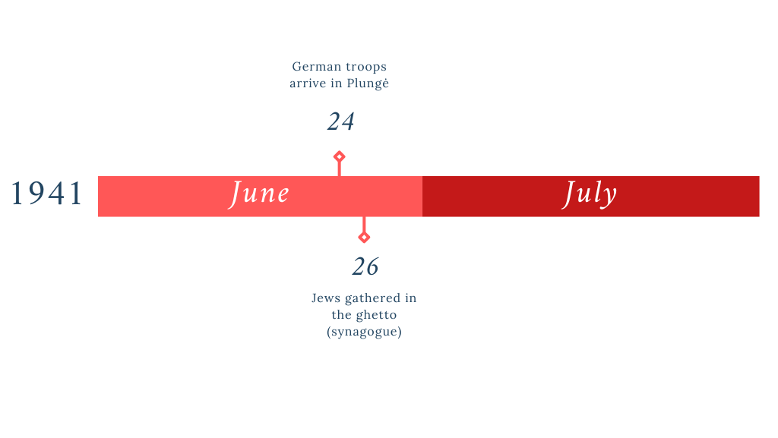
Timeline of the Events in Plungė

Slide 27
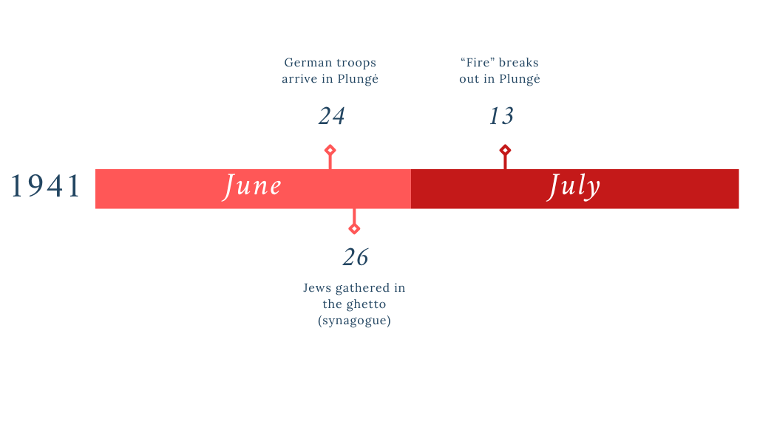
Timeline of the Events in Plungė

Slide 28
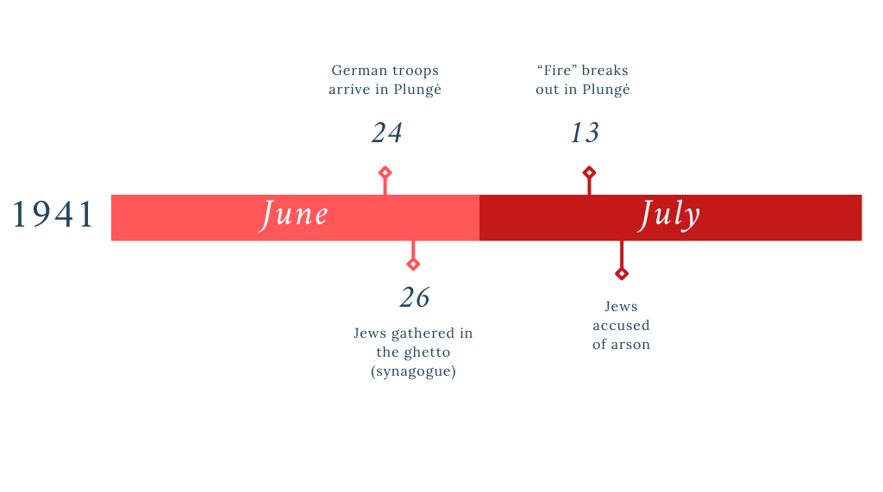
Timeline of the Events in Plungė

Slide 29
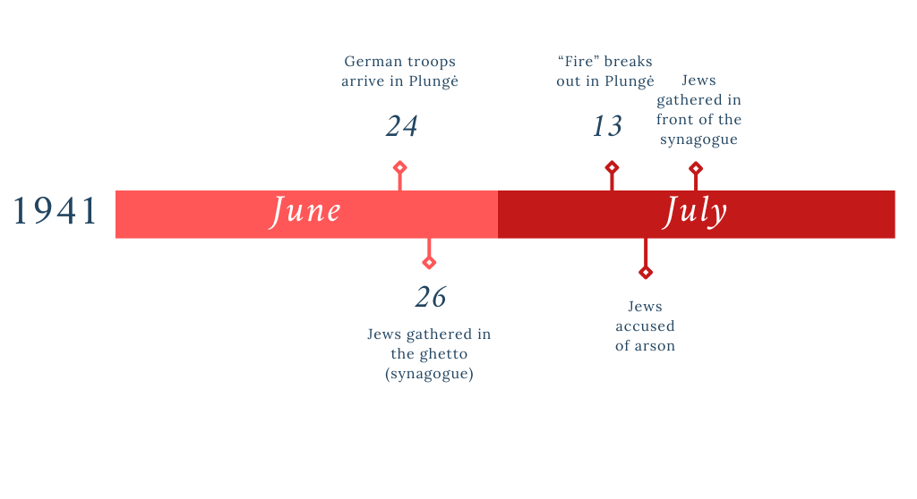
Timeline of the Events in Plungė

Slide 30
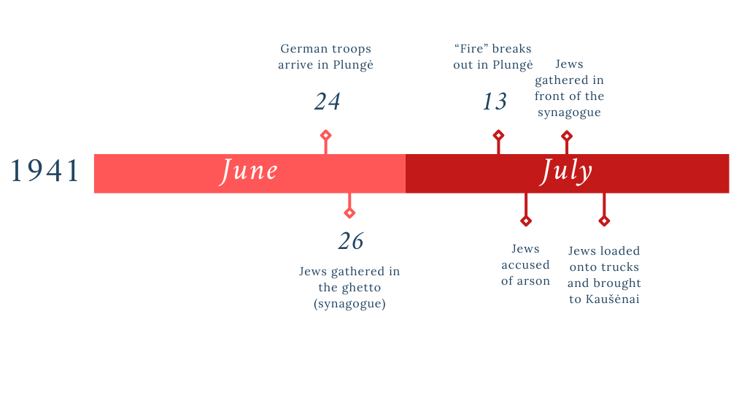
Timeline of the Events in Plungė

Slide 31

Timeline of the Events in Plungė

Slide 32
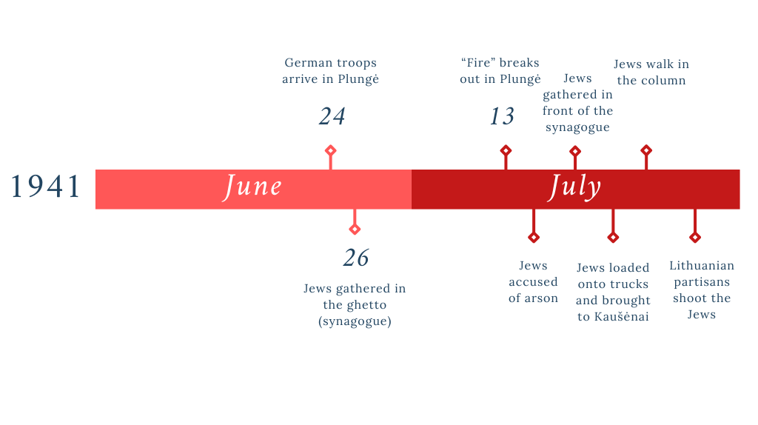
Timeline of the Events in Plungė

Slide 33
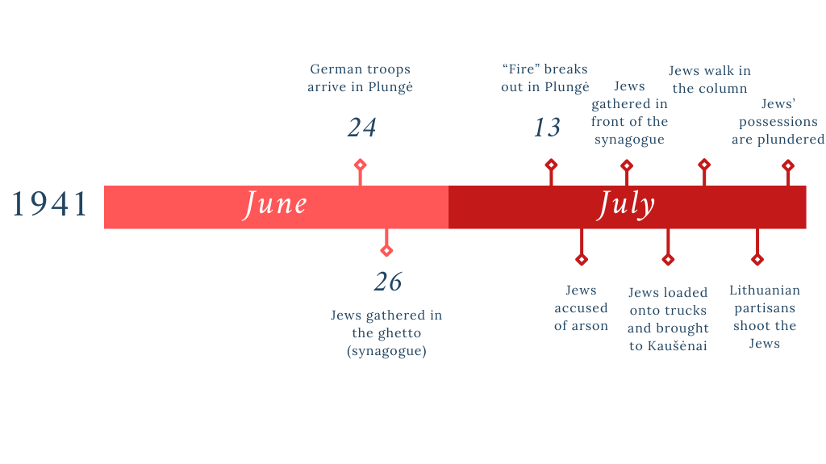
Timeline of the Events in Plungė

Slide 34
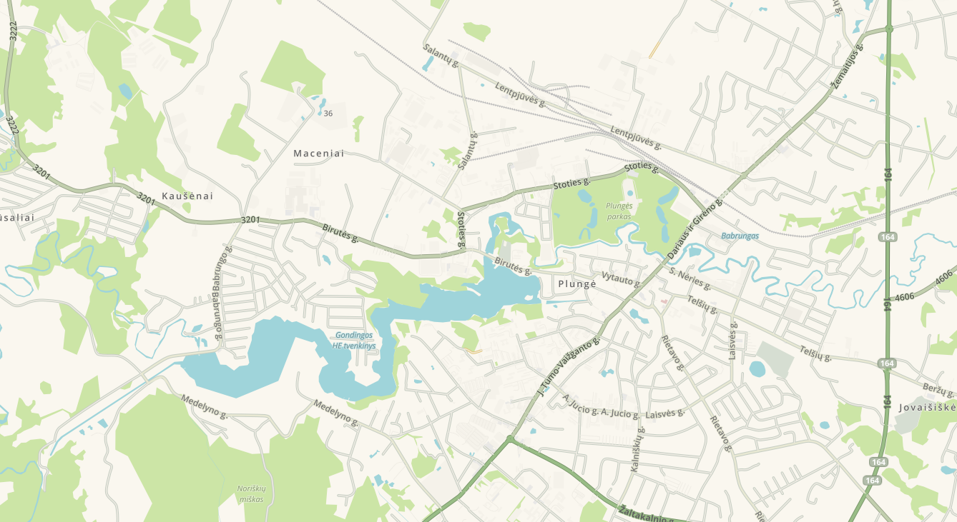
Map of the Events in Plungė
Maceniai
Killing site
Kaušėnai
Plungė
Ghetto (synagogue)
Noriškiai
Basemap from Waze

Slide 35
Why is it important to study the Holocaust by Bullets?

Slide 36
Why should we use witness testimonies to supplement archival sources when investigating historical events?

Slide 37
How can learning about the Holocaust by Bullets help us better understand today’s challenges such as antisemitism or mass violence?

Slide 38
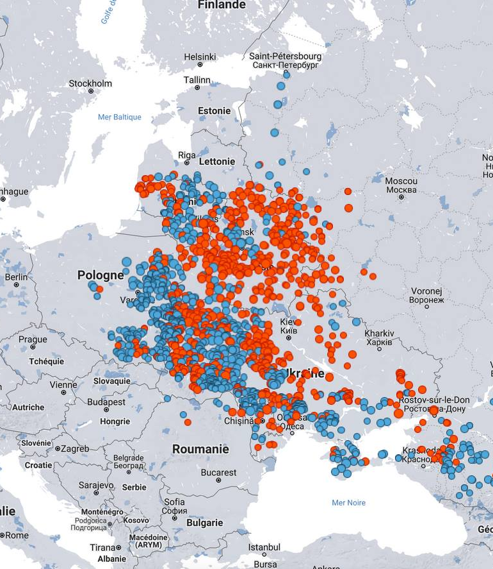
yahadmap.org

